Slide 1
Walgreens Pharmacy

Slide 2
Values
Care: act with commitment and passion
Innovation
Partnership
Dedication
Trust
Diversity
Teamwork

Slide 3
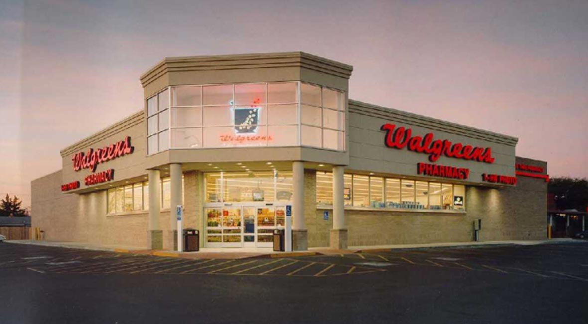
Walgreens Pharmacy

Slide 4
About Walgreens pharmacy
Mission Statement:
To be America's most-loved pharmacy-led health, well-being and beauty company.
They keep on coming up with new ways to satisfy their customers.
Vision statement
To be America's top-rated pharmacy by providing their customers with the most high-quality products.
Walgreens wants to be in the top-ranked pharmacies in the states.
They have been working on improving that through their services and products

Slide 5
Swot analysis
Strengths
An experienced management that makes good investment decisions.
A broad customer base
A well-known brand name
Technological advancements that help them deliver.
A digital lab that enhances efficiency.
Broad market all over the U.S.

Slide 6
Strengths cont.
Company assets
Greatest economies of scale
Use of snapfish technology is a source of strength
Customer service
Geographical expansion

Slide 7
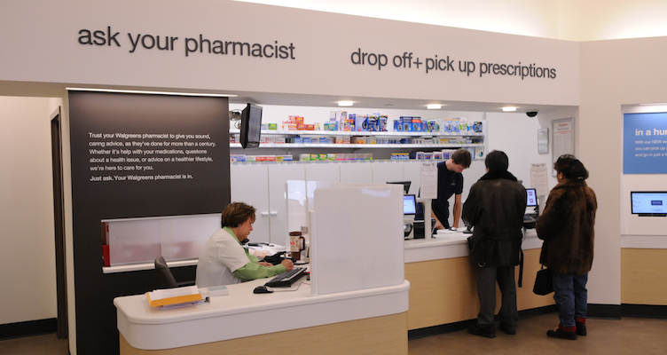
Well experience pharmacy

Slide 8
Weaknesses
Fewer company acquisitions
Lack of consistency in implementation of store policies.
Less parking space has been an issue
Corporate image
Lack of control on production of drugs

Slide 9
Opportunities case
The company’s services are deemed the best
Technological innovations
Growth potential
Customer loyalty
Can try foreign growth

Slide 10
Threats
Competitive price pressures
New entrants
Existing market competitors
Barriers to new entrants are few
Substitutes like hospitals

Slide 11


Slide 12
Representation of the expectations and their measurements.- financial aspect
Goals | Measure
Increase net profits | Total sales made minus costs and expenses
Reduce costs of after sale services | Cost percentage to business value
Increase business value | Using the balance sheet

Slide 13
Customer aspect
Goals | Measure
Coverage | Reports from our customers
Maintain existing customer base | Customer appearances and competitor reports
Increase quality, availability is an aspect of quality | Customer reports and speak outs when they come to buy

Slide 14
Learning and Growth Aspect
Goals | Measure
Live the company’s dream | Internal reports when we make plans
Increase quality, availability is an aspect of quality | Customer reports and speak outs when they come to buy
Exploring new opportunities | Success/dispose reports of the venture

Slide 15
Internal Aspect
Internal aspect
Goals | Measure
Enlarge company’s market share | Sales reports recorded in the sales journal
Social advantages, community acceptability | Relations to the immediate community
Overall company growth | Number of projects running or being implemented

Slide 16
Summary
Walgreens Pharmacy has a broad brans name and customer loyalty.
It has an experienced management that makes the best financial decisions.
It has many opportunities that can help it expand.
Technological advancements can help them remain on top.
Walgreens should focus on improving service delivery.

